Slide 1
Sentiment Analysis of Twitter data
May - July 2017
Notes:
To change the logo in the footer, go to the VIEW menu > Master > Slide Master, and replace the existing logo by your entity's logo.
To edit the confidentiality level, go to the INSERT menu > Header and footer, and fill in the desired level.

Slide 2
Overview of the project
Collection of tweets in the last 5 hours using the provided handles and keywords
Unsupervised Approach
Chart with distribution of Semantic Orientation of tweets.
Building positive and negative word dictionary
Notes:
Page numbers are flushed right using the tab function ("->” key or "TAB" key), and are formatted manually (Century 12 pt., dark blue).
Chapters are numbered automatically.
To edit the footer for the entire document, go to INSERT > Header and footer, and fill in the desired titles and dates.
The vertical line should be adjusted manually.

Slide 3
Approach
Objective
Classification of the tweets into 2 categories of sentiments:
Positive
Negative
Data
Set Collection
Tweets collected from the internet
Wikipedia Corpus used
Google’s pre-trained News corpus word2vec model
Framework
Pre-processing of the data
Extraction of phrases using a set of grammar rules
Calculation of Semantic Orientation of each of the phrases collected
Used Pointwise Mutual Information and Word2Vec vectorizations.
Net Semantic Orientation of a tweet
Classification based on this value
Graphical Analysis
Plots showing distribution of Semantic Orientation of tweets
Dictionary building
Building positive and negative word dictionary
Notes:
Page numbers are flushed right using the tab function ("->” key or "TAB" key), and are formatted manually (Century 12 pt., dark blue).
Chapters are numbered automatically.
To edit the footer for the entire document, go to INSERT > Header and footer, and fill in the desired titles and dates.
The vertical line should be adjusted manually.

Slide 4

Data Set collection:
Tweets collected from the internet
Initial twitter data set contained 5 labels:
Positive
Negative
Neutral
Objective
Objective-OR-Neutral
A total of around 8179 positive and negative tweets collected
Tweets contain
Hash Tags (e.g #sunny, #beautifulmorning)
Mentions of user names(e.g @Leo)
Emoticons (e.g ☺, ☹)
Hyper links (starting with http://__ , https://__ , www.__ )
Wikipedia Corpus
A collection of around 164 text files
Contains around 600 million tokens
Used for calculation of frequency of co-occurrence of phrases and seed words
Google’s pre-trained News corpus word2vec model
Includes word vectors for a vocabulary of 3 million words and phrases
Trained on roughly 100 billion words from a Google News dataset.
Vector length is 300 features.
Notes:
Page numbers are flushed right using the tab function ("->” key or "TAB" key), and are formatted manually (Century 12 pt., dark blue).
Chapters are numbered automatically.
To edit the footer for the entire document, go to INSERT > Header and footer, and fill in the desired titles and dates.
The vertical line should be adjusted manually.

Slide 5
Pre-Processing Step: Reducing the tweets to consistent forms
Tweets with ‘positive’ and ‘negative ‘labels were kept. Rest (‘objective’,’neutral’,’objective-OR-neutral’) were discarded
Tweets were reduced to lower case
Additional white spaces were removed
Hyperlinks (starting with www. or https?), Target words (@username), Hashtags (#), Punctuations and Emoticons were removed using RegEx techniques.
Acronyms and slangs were replaced by their full length words using a manually-curated list of Internet Slang and Acronyms
Notes:
Page numbers are flushed right using the tab function ("->” key or "TAB" key), and are formatted manually (Century 12 pt., dark blue).
Chapters are numbered automatically.
To edit the footer for the entire document, go to INSERT > Header and footer, and fill in the desired titles and dates.
The vertical line should be adjusted manually.

Slide 6
Model 1: Using Wikipedia Corpus

Slide 7


Algorithm: Sentiment Classification of Tweets Using PMI
Use POS tagger to assign parts of speech to each token
Extract phrases from the text when their tags conform to certain patterns.
Calculation of SO* of the phrases using PMI**
Calculate SO* of each phrase
Calculate PMI(phrase, good) and PMI(phrase, bad)
Use Pair of seed words(‘good’, ‘bad’) to find SO*
Compute SO* of the tweets by adding the SOs of all its phrases
*SO=Semantic Orientation
**PMI=Pointwise Mutual Information
Notes:
Page numbers are flushed right using the tab function ("->” key or "TAB" key), and are formatted manually (Century 12 pt., dark blue).
Chapters are numbered automatically.
To edit the footer for the entire document, go to INSERT > Header and footer, and fill in the desired titles and dates.
The vertical line should be adjusted manually.

Slide 8

Algorithm: Building Dictionary
Update positive words list with positive extracted words and negative word list with negative extracted words
Take ‘good’ in the positive words list and ‘bad’ in the negative words list as reference
Extract top k words with highest positive SO values and highest negative SO values
Extract all adjectives in the tweets
Calculate SO values of each adjective. Use PMI(adjective, +ve words) and PMI(adjective, -ve words)
*PMI=Pointwise Mutual Information

Slide 9
Multi-processing: Dealing with the huge Wikipedia Corpus
The Wikipedia corpus contains roughly 600 million words. One search traversal through the whole corpus in a single process involves huge amount of computation
A single tweet containing 1 phrase takes ~200 seconds to calculate Semantic Orientation with just a pair of seed words
To reduce the computation time, multi-processing technique was used
The Wikipedia corpus was divided into 4 sections, and 4 processes were run on these 4 sections simultaneously for calculation of the Semantic Orientation
This reduced the CPU time from ~200 seconds to ~55 seconds
Notes:
Page numbers are flushed right using the tab function ("->” key or "TAB" key), and are formatted manually (Century 12 pt., dark blue).
Chapters are numbered automatically.
To edit the footer for the entire document, go to INSERT > Header and footer, and fill in the desired titles and dates.
The vertical line should be adjusted manually.

Slide 10
Considering emoticons
Identification of the positive and negative emoticons
A comprehensive list of emoticons with polarity {+1,-1} was obtained from a source, which acted as a look up table for identifying the positive and negative emoticons
Number of positive and negative emoticons in a tweet was calculated

Slide 11
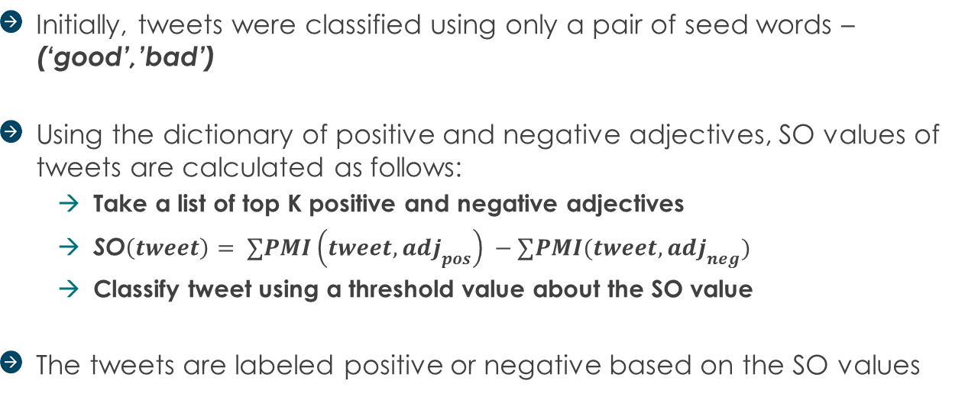
Classification with newly built dictionary
Initially, tweets were classified using only a pair of seed words – (‘good’,’bad’)
Using the dictionary of positive and negative adjectives, SO values of tweets are calculated as follows:
Take a list of top K positive and negative adjectives
SO$\left(tweet\right)= ∑PMI\left(tweet,adj_{pos}\right) −∑PMI(tweet,adj_{neg})$
Classify tweet using a threshold value about the SO value
The tweets are labeled positive or negative based on the SO values

Slide 12
Model 2: Using Word2vec

Slide 13
Word2Vec
Word2vec is used to produce word embeddings.
Skip-gram neural network model was chosen, which trains a neural network (1 hidden layer) for a word over the text corpus.
The hidden layer of the neural network is the desired word embedding of the word
So Word2vec takes as its input a large corpus of text and produces a vector space, with each unique word in the corpus being assigned a corresponding vector in the space.
Google’s word2vec model pre-trained over Google News dataset was used to derive the vector representation of words.
The vectors had 300 features.

Slide 14
Algorithm: Sentiment Classification of Tweets Using Word2Vec Vectorizations
Extract phrases based on aforesaid grammar rules
Use ‘good’ as Positive seed and ‘bad’ as Negative seed.
Represent ‘good’, ’bad’ and phrase in vector form using Word2vec.
To represent phrase as vector, take average of Word2Vec(word1) & Word2Vec(word2)
Calculate cosine similarity of vector representation of (phrase,good) and (phrase,bad).
Take difference of positive and negative cosine similarity to get similarity score of phrase.
Add similarity score of all phrases to get similarity score of tweet.
Classify tweets as ‘positive’ and ‘negative’ using similarity score about a threshold value

Slide 15
Algorithm: Building dictionary using Word2Vec Vectorizations
Extract list of adjectives from tweets for dictionary building.
Calculate cosine similarity of adjectives with ‘good’ and ‘bad’ separately.
Take difference of positive and negative semantic similarity to get similarity scores.
Add top k adjectives to positive dictionary and bottom k to negative dictionary

Slide 16
Model 3: Ensemble of model 1 and 2

Slide 17
Ensemble of the two models
Equal weightage given to the 2 previous models and so average score was taken into consideration
SO scores and cosine similarity scores normalized and scaled down to the range[-1,1] by dividing the scores with the maximum of the absolute value of all the scores.

Slide 18
Graphical Analysis

Slide 19
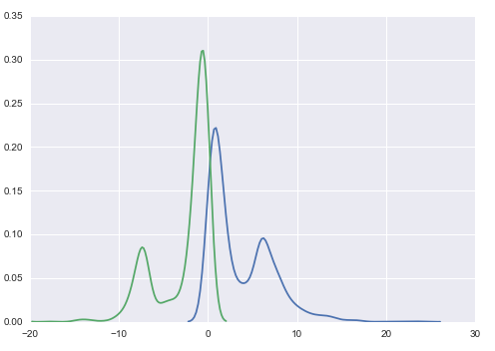

KDE Plots
Plot of distribution of SO of tweets obtained using Wikipedia Corpus
*SO-Semantic Orientation

Slide 20
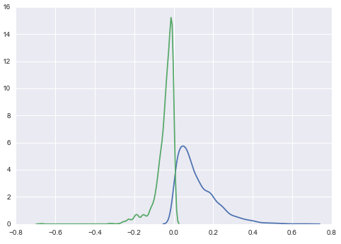
KDE Plots
Plot of distribution of similarity scores of tweets obtained using Word2Vec

Slide 21
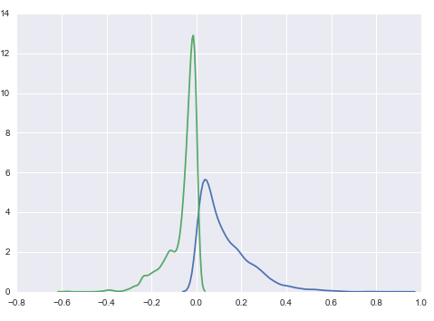
KDE Plots
Plot of distribution of scores of tweets combining the scores of 2 models

Slide 22
Results : Model 1 (using Wikipedia Corpus)
Confusion Matrix :
 | Predicted: NO | Predicted: YES
Actual: NO | 480 | 966
Actual: YES | 1016 | 2367
Precision score : 0.71
Recall score : 0.70
F1 score : 0.70
Accuracy score : 0.59
Notes:
Page numbers are flushed right using the tab function ("->” key or "TAB" key), and are formatted manually (Century 12 pt., dark blue).
Chapters are numbered automatically.
To edit the footer for the entire document, go to INSERT > Header and footer, and fill in the desired titles and dates.
The vertical line should be adjusted manually.

Slide 23
Results : Model 2 (using Word2Vec)
Confusion Matrix :
 | Predicted: NO | Predicted: YES
Actual: NO | 645 | 1320
Actual: YES | 860 | 3739
Precision score : 0.74
Recall score : 0.81
F1 score : 0.77
Accuracy score : 0.67
Notes:
Page numbers are flushed right using the tab function ("->” key or "TAB" key), and are formatted manually (Century 12 pt., dark blue).
Chapters are numbered automatically.
To edit the footer for the entire document, go to INSERT > Header and footer, and fill in the desired titles and dates.
The vertical line should be adjusted manually.

Slide 24
Results : Model 2 (using Word2Vec with built dictionary)
Confusion Matrix :
 | Predicted: NO | Predicted: YES
Actual: NO | 546 | 800
Actual: YES | 1389 | 3687
Precision score : 0.82
Recall score : 0.72
F1 score : 0.77
Accuracy score : 0.66
Notes:
Page numbers are flushed right using the tab function ("->” key or "TAB" key), and are formatted manually (Century 12 pt., dark blue).
Chapters are numbered automatically.
To edit the footer for the entire document, go to INSERT > Header and footer, and fill in the desired titles and dates.
The vertical line should be adjusted manually.

Slide 25
Results : Model 3 (Ensemble of Model 1 & 2)
Confusion Matrix :
 | Predicted: NO | Predicted: YES
Actual: NO | 620 | 1358
Actual: YES | 917 | 3723
Precision score : 0.73
Recall score : 0.80
F1 score : 0.76
Accuracy score : 0.65
Notes:
Page numbers are flushed right using the tab function ("->” key or "TAB" key), and are formatted manually (Century 12 pt., dark blue).
Chapters are numbered automatically.
To edit the footer for the entire document, go to INSERT > Header and footer, and fill in the desired titles and dates.
The vertical line should be adjusted manually.

Slide 26
Comparison of models :
Model 1 : Using wikipedia corpus
Model 2 : Using word2vec model
Model 3 : Average of model 1 and 2
 | Model 1 | Model 2 | Model 3
Without Neutral tweets | 58.95% | 66.78% | 65.62%
With Neutral tweets | 34.82% | 53.60% | 53.10%
Notes:
Page numbers are flushed right using the tab function ("->” key or "TAB" key), and are formatted manually (Century 12 pt., dark blue).
Chapters are numbered automatically.
To edit the footer for the entire document, go to INSERT > Header and footer, and fill in the desired titles and dates.
The vertical line should be adjusted manually.

Slide 27
Problems Faced: How did we over come the stumbling blocks?
Fetching of tweets :
Tweets couldn’t be fetched from Twitter API due to restrictions on AXA servers
A hand-annotated labeled data set obtained from a source was used instead
Calculation of Semantic Orientation (SO):
IR (Internet Retrieval) methods like search query hits could not be used due to restrictions on interactions with Search Engine APIs on AXA servers
Wikipedia Corpus used which contains text from all categories
Dealing with the huge Wikipedia Corpus:
Sentiment Prediction of a single tweet(containing 1 phrase) would take ~3 minutes
Computation time reduced to under 1 minute using Multiprocessing technique
Notes:
Page numbers are flushed right using the tab function ("->” key or "TAB" key), and are formatted manually (Century 12 pt., dark blue).
Chapters are numbered automatically.
To edit the footer for the entire document, go to INSERT > Header and footer, and fill in the desired titles and dates.
The vertical line should be adjusted manually.

Slide 28
Appendix

Slide 29
Pattern for selecting phrases
We pick up trigrams from the corpus and extract those bigrams as phrases if any of the following patterns are followed:
First Word | Second word | Third Word (not extracted)
JJ | NN or NNS | anything
RB, RBR or RBS | JJ | Not NN or NNS
JJ | JJ | Not NN or NNS
NN or NNS | JJ | Not NN or NNS
RB, RBR, RBS | VB,VBD, VBN or VBG | anything

Slide 30
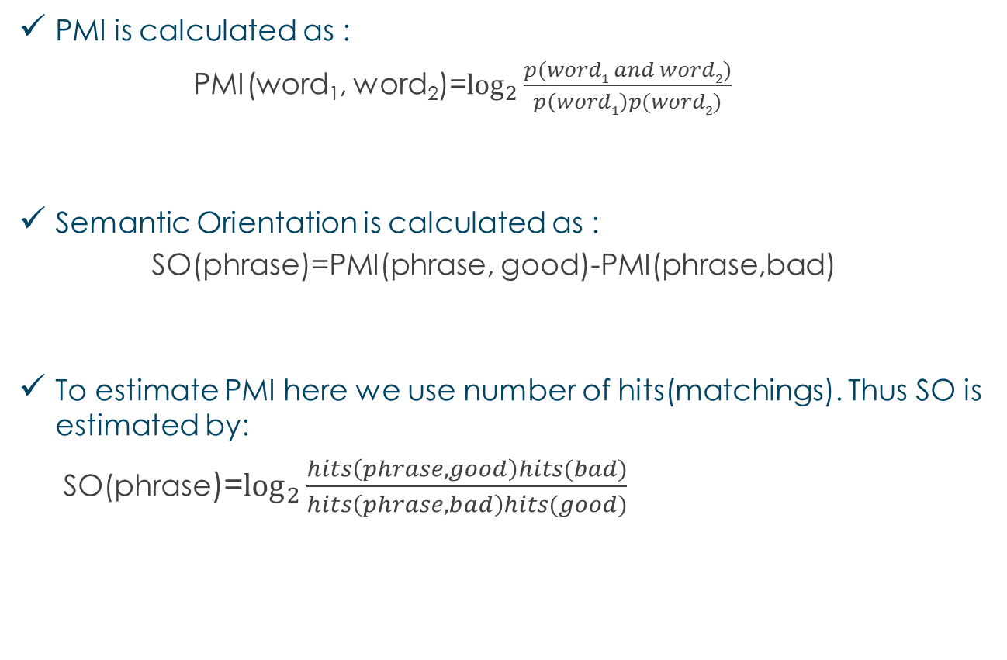
Formulas
PMI is calculated as :
PMI(word₁, word₂)=$\log_{2}{\frac{p(word1 and word2)}{p\left(word1\right)p(word2)}}$
Semantic Orientation is calculated as :
SO(phrase)=PMI(phrase, good)-PMI(phrase,bad)
To estimate PMI here we use number of hits(matchings). Thus SO is estimated by:
SO(phrase)=$\log_{2}{\frac{hits\left(phrase,good\right)hits(bad)}{hits\left(phrase,bad\right)hits(good)}}$

Slide 31
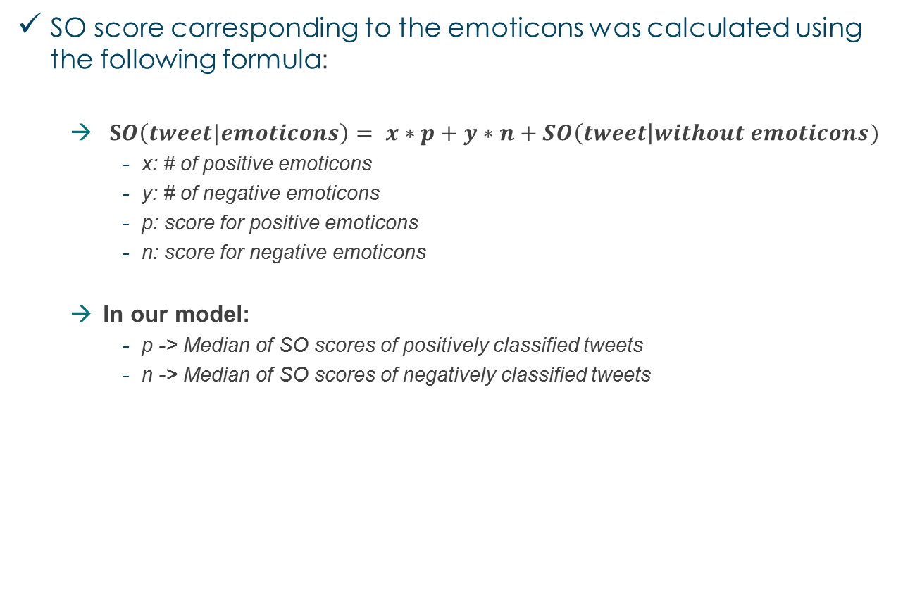
Formulas
SO score corresponding to the emoticons was calculated using the following formula:
$SO\left(tweet|emoticons\right)= x∗p+y∗n+SO\left(tweet\right|without emoticons)$
x: # of positive emoticons
y: # of negative emoticons
p: score for positive emoticons
n: score for negative emoticons
In our model:
p -> Median of SO scores of positively classified tweets
n -> Median of SO scores of negatively classified tweets

Slide 32
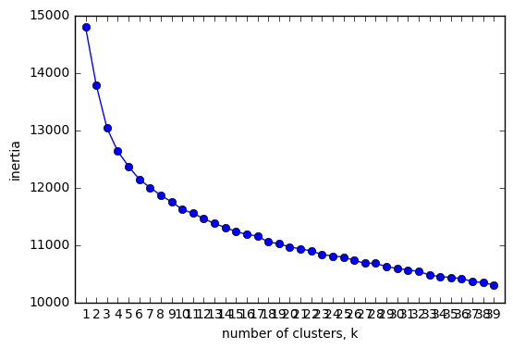
K-Means
Algorithm:
Form K clusters
Assign label to clusters corresponding to majority label of tweets in the cluster
Classify new tweet by finding the nearest cluster and assigning it’s label
The hyper-parameter K (# of clusters) was chosen by interpreting the inertia plots

Slide 33
References

Slide 34
References
Peter D. Turney. 2002. Thumbs Up or Thumbs Down? Semantic Orientation Applied to Unsupervised Classification of Reviews. Proceedings of the 40th Annual Meeting of the Association for Computer Linguistics (ACL) (pp. 417 – 424).
John Rothfels, Julie Tibshirani. 2010. Unsupervised Sentiment classification of English movie reviews using automatic selection of positive and negative sentiment items. Technical Report, Department of Natural Language Processing, Stanford University.
Samuel Reese, Gemma Boleda, Montse Cuadros, Lluís Padró, German Rigau. Wikicorpus: A Word-Sense Disambiguated Multilingual Wikipedia Corpus. In Proceedings of 7th Language Resources and Evaluation Conference (LREC'10), La Valleta, Malta. May, 2010
<http://www.cs.upc.edu/~nlp/wikicorpus/>
Tomas Mikolov, Ilya Sutskever, Kai Chen, Greg Corrado, and Jeffrey Dean. Distributed Representations of Words and Phrases and their Compositionality. In Proceedings of NIPS. 2013.
<://tinyurl.com/hg9x6bq>

Slide 35
THANK YOU
Notes:
To change the logo in the footer, go to the VIEW menu > Master > Slide Master, and replace the existing logo by your entity's logo.
To edit the confidentiality level, go to the INSERT menu > Header and footer, and fill in the desired level.

